Slide 1
Saving Sensor Data Into a Text File
CSE315
Peripheral And Interfacing

Slide 2
What is SD?
The SD modules allow you to communicate with the memory card and write or read the information on them.
The communication between the Arduino and the SD card uses SPI which takes place on digital pins 11, 12, and 13, Additionally, another pin must be used to select the SD card. This can be the hardware SS pin – pin 10

Slide 3
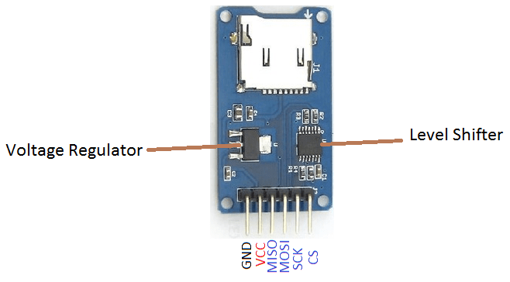
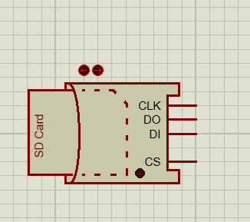
Pin Configuration:

Slide 4
Required Components:
Arduino Uno
Sonar Sensor
SD Card Module
LED
POT
POT HG
Virtual Terminal

Slide 5
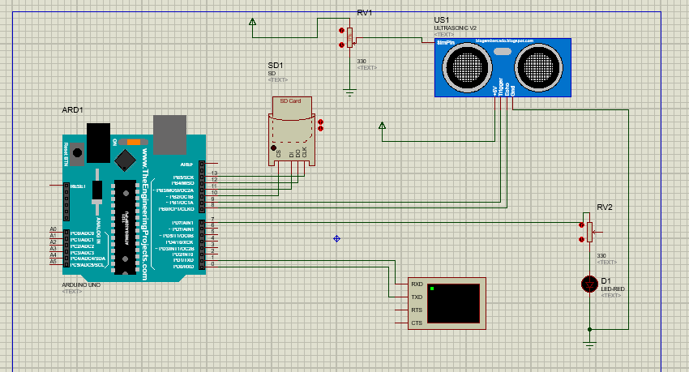

Slide 6
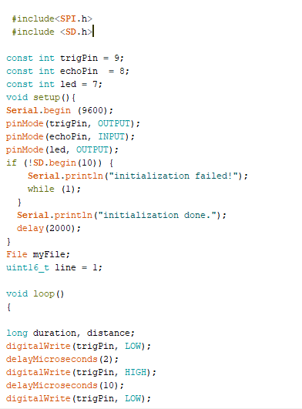
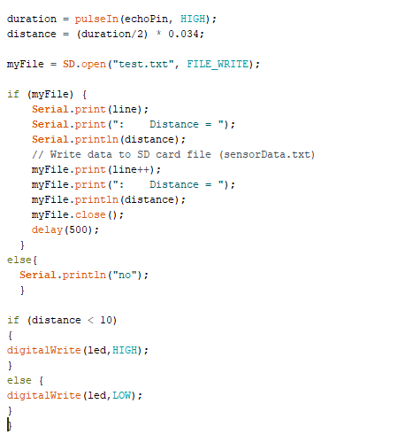

Slide 7

In the simulation we have to provide a dedicated space for the SD module that will work as a sd card
To create a space for the sd module we have to use WinImage Application
https://www.winimage.com/download.htm

Slide 8
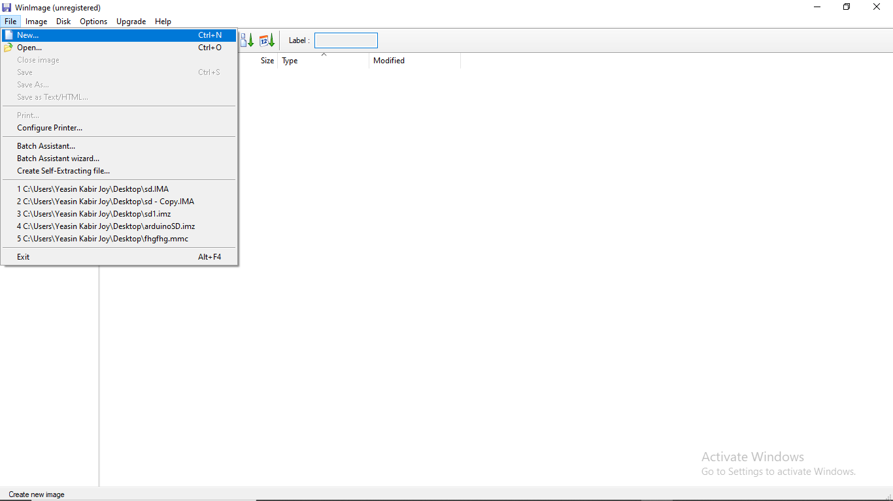


Slide 9
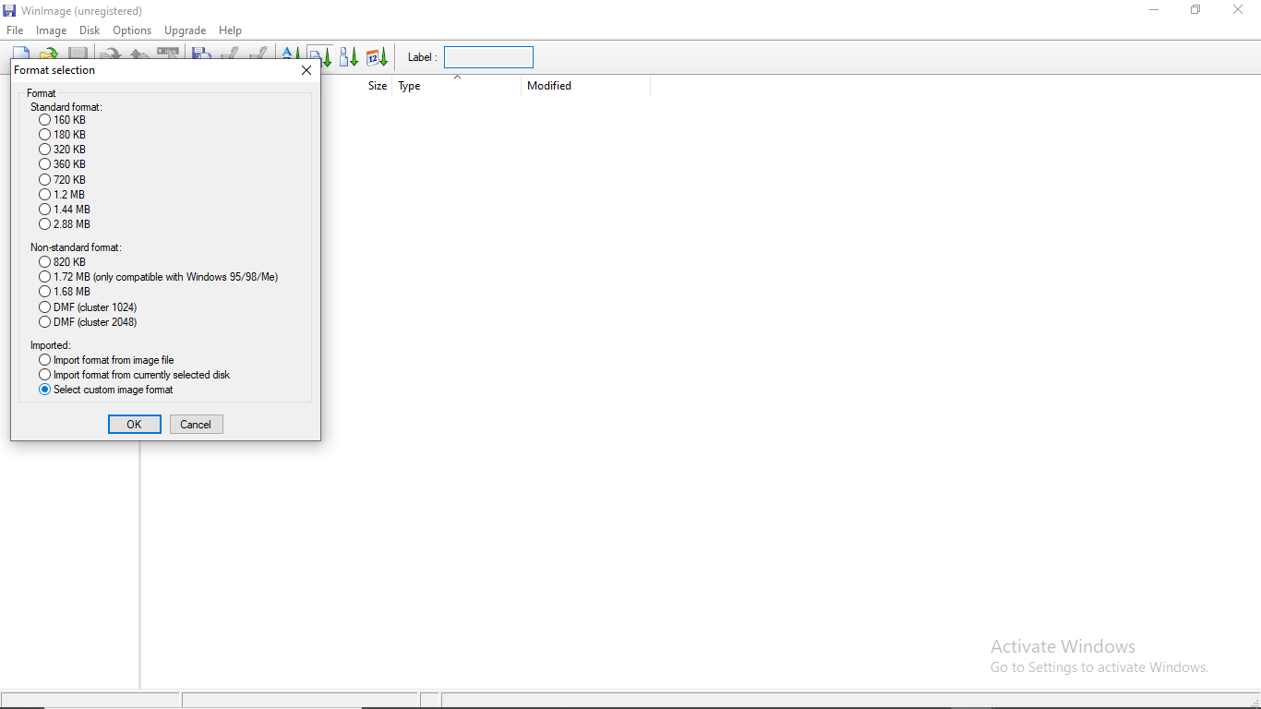

Slide 10
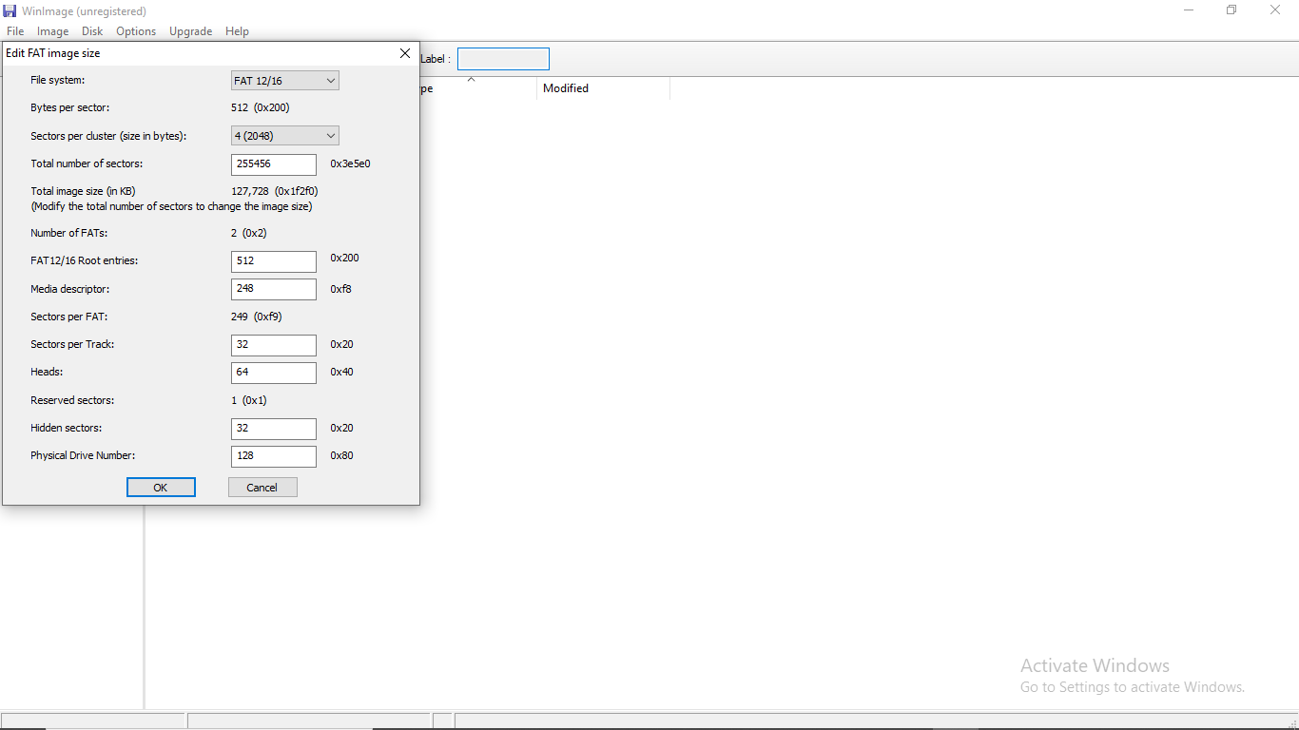

Slide 11
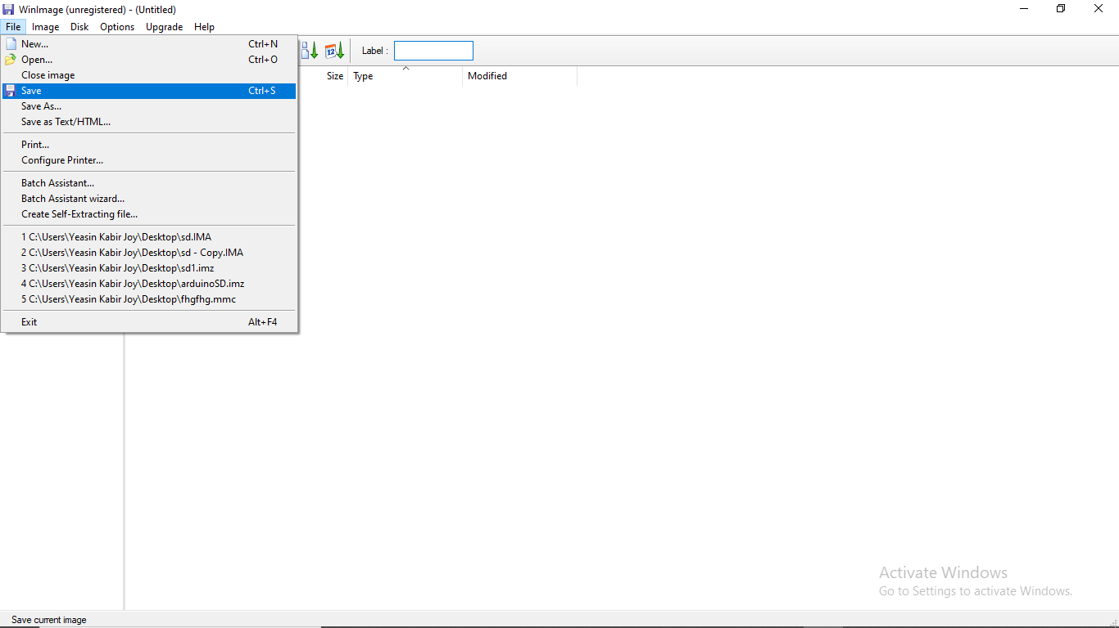

Slide 12
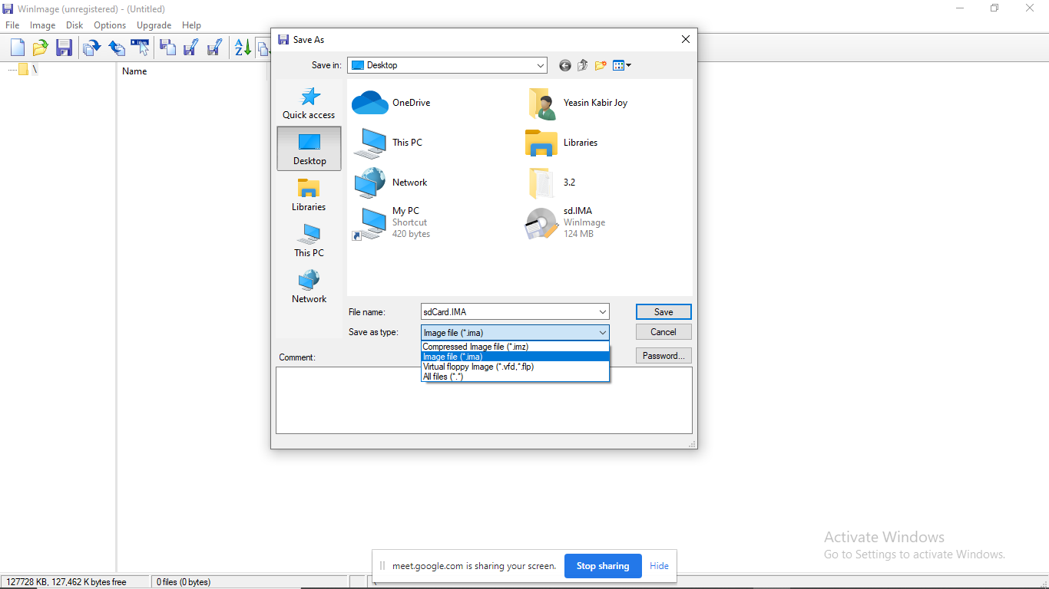

Slide 13
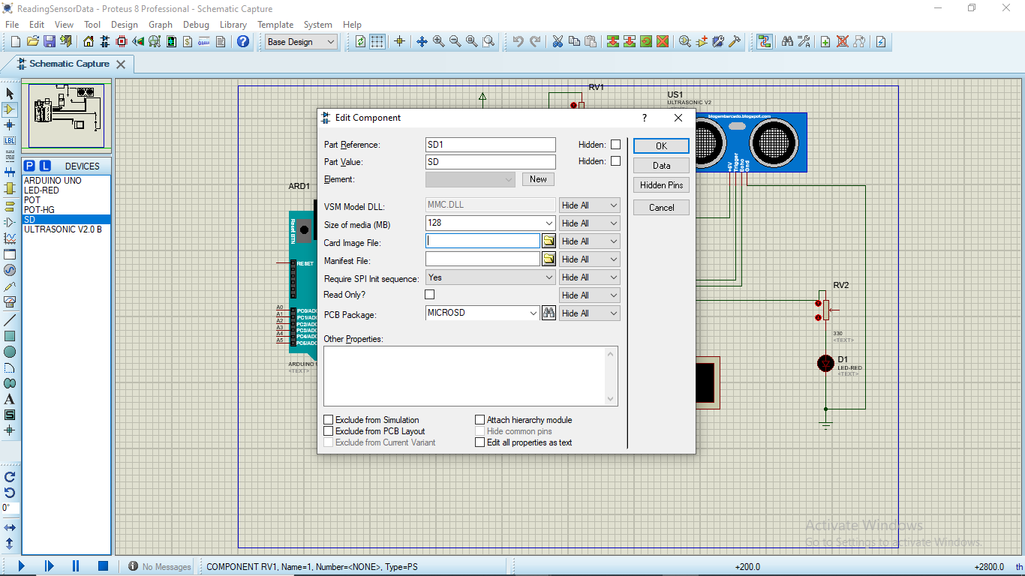

Slide 14
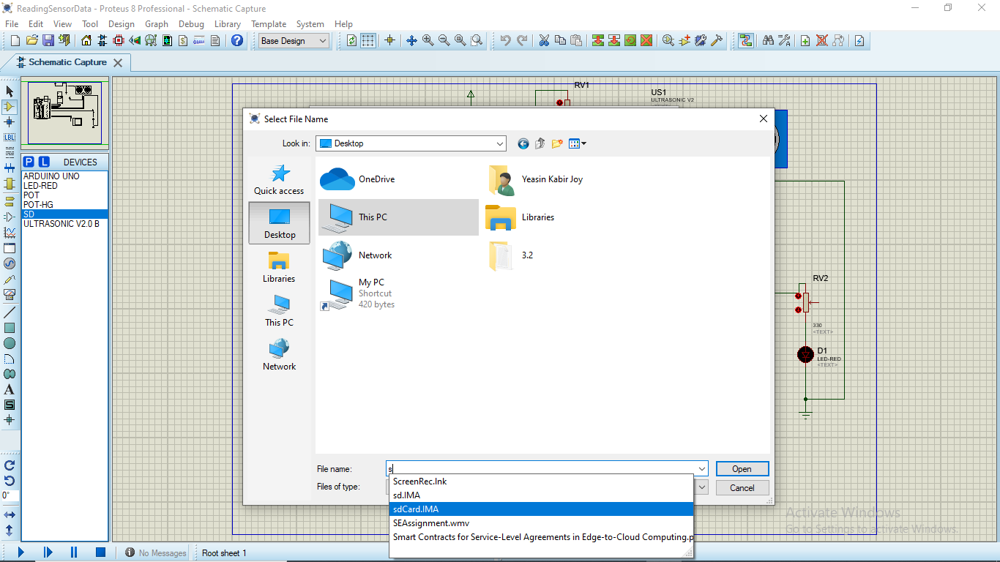

Slide 15
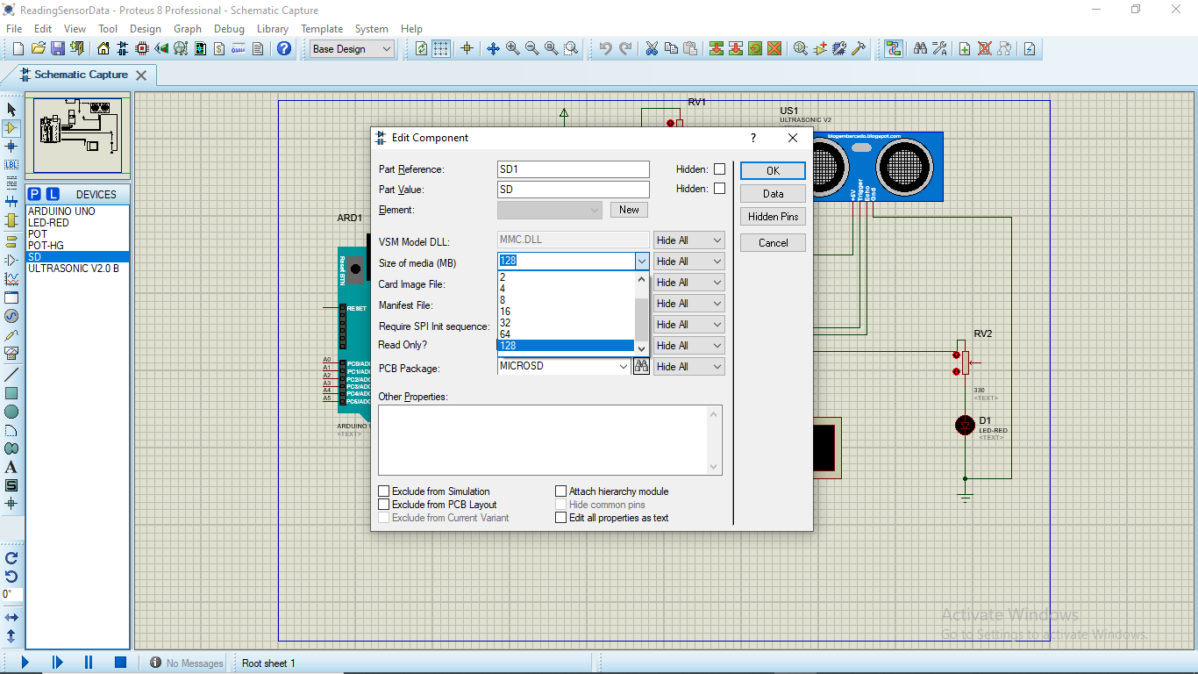

Slide 16
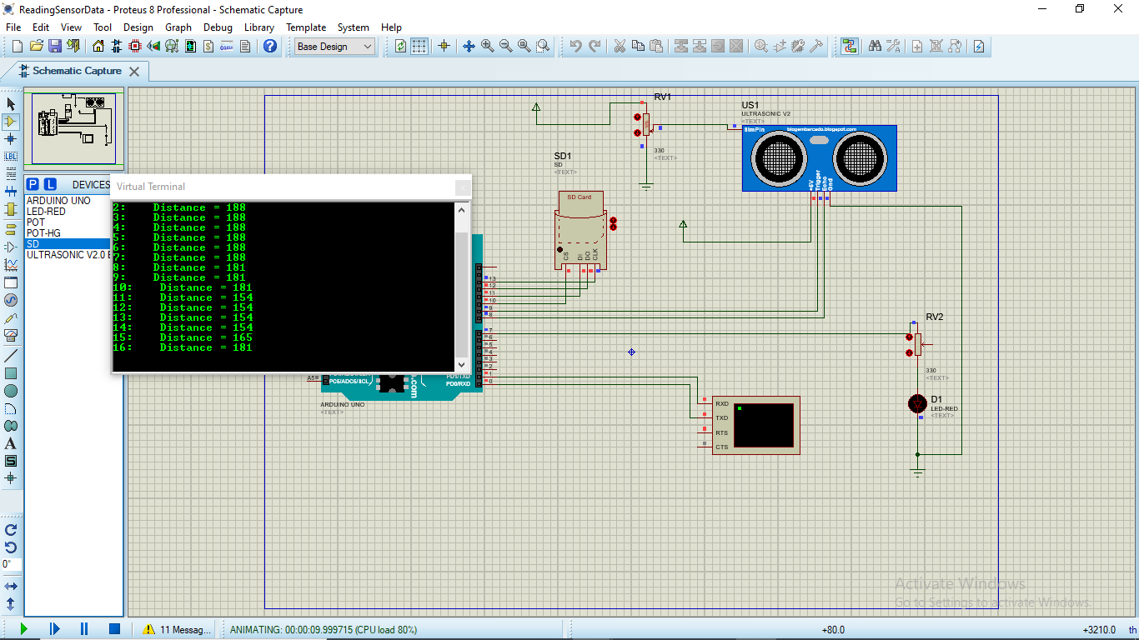

Slide 17
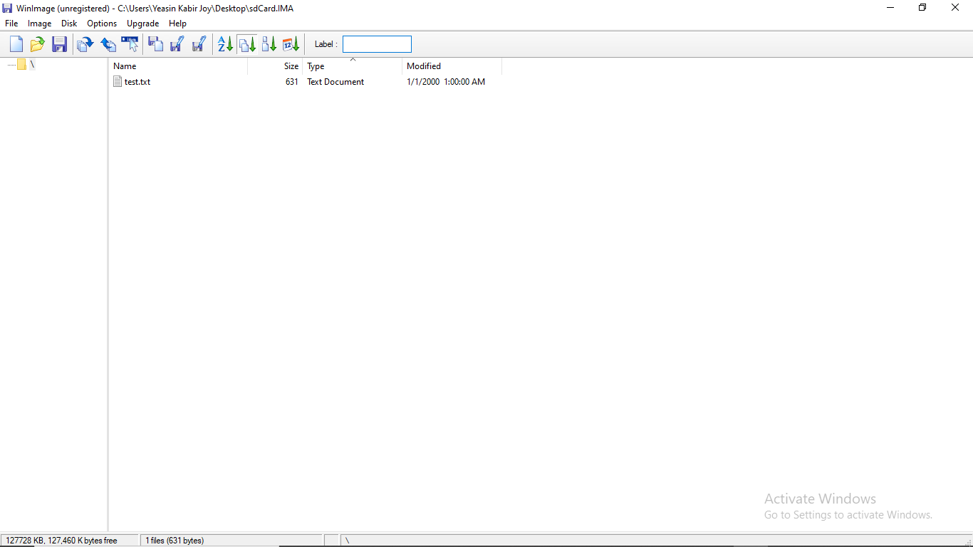

Slide 18
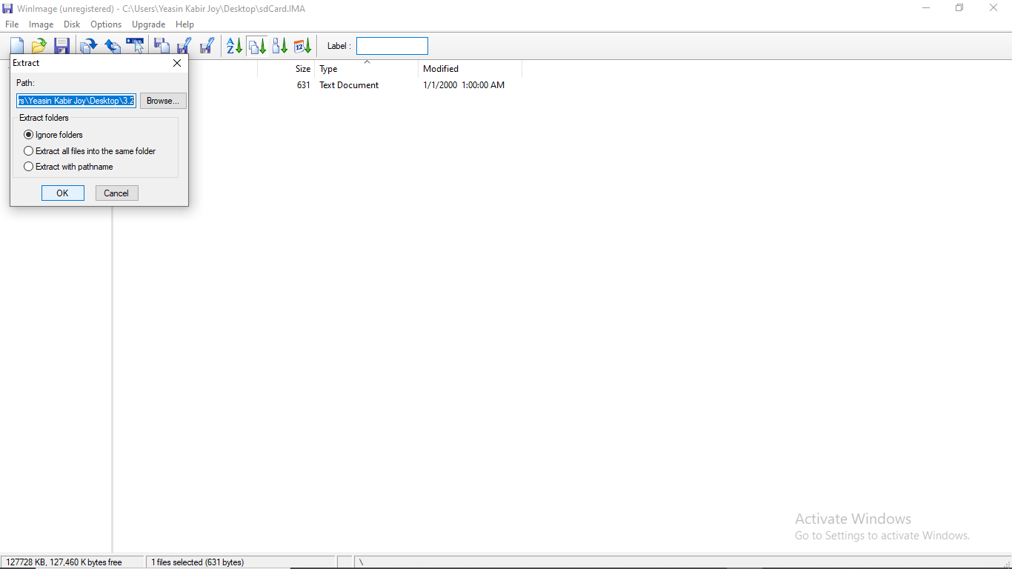

Slide 19
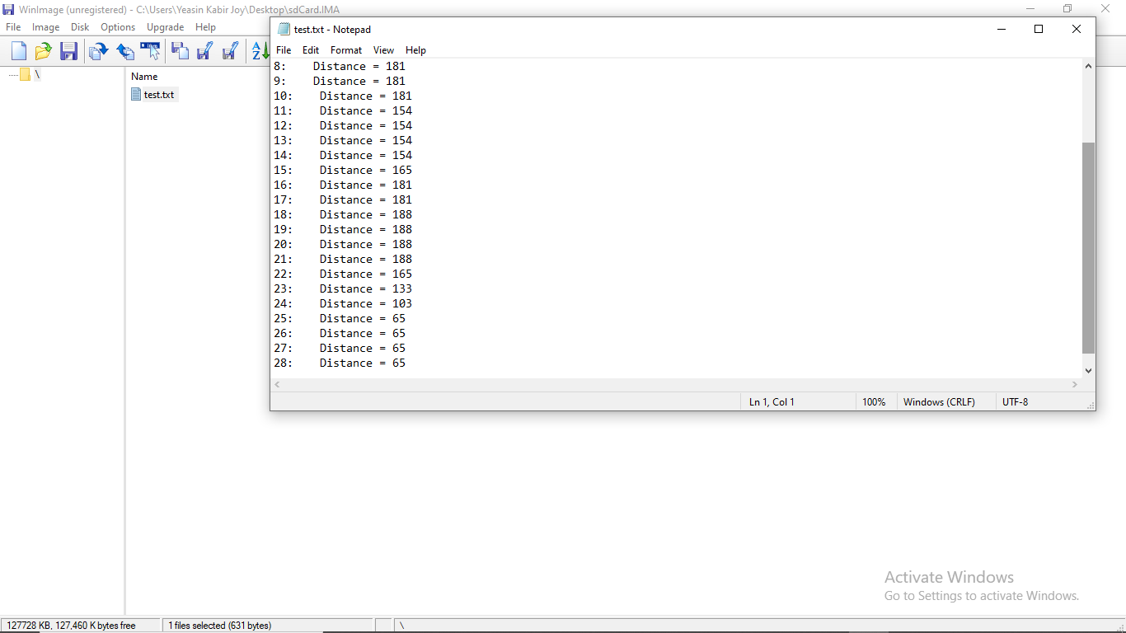

Slide 20
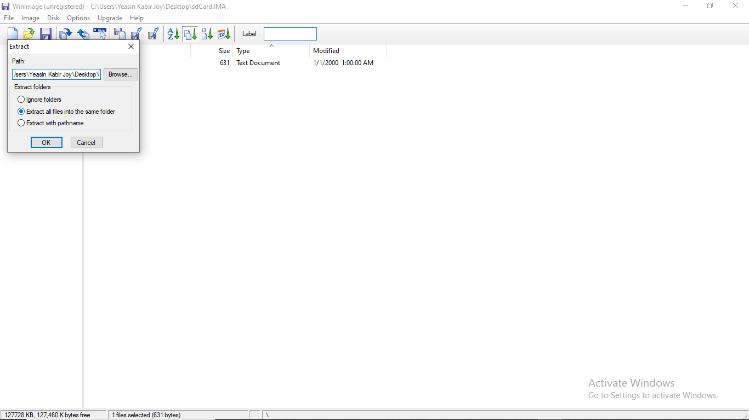

Slide 21
Thank You!!

